Slide 1
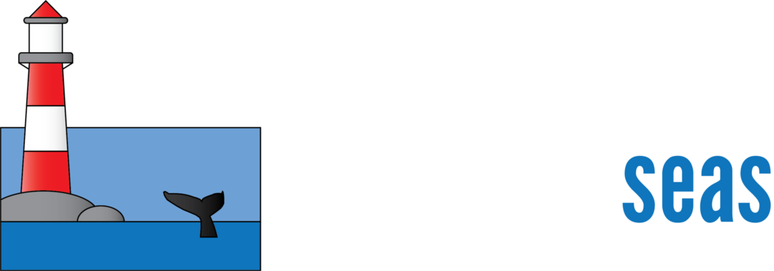
S-121, S-122 Interoperability
Virgil Zetterlind
virgil@anthinst.org
Notes:
We are the Anthropocene Inst a privately funded conservation foundation. Part of our mission is to promote and enhance ocean conservation, and is accomplished by the Protected Seas. Protected Seas focuses on ocean conservation, specifically marine managed area mapping. Here we are creating a comprehensive database of marine managed areas location and rules and regulations.

Slide 2
S-121 Maritime Limits and Boundaries
Core Elements
Limits (Lines or Points)
Baselines (Lines or Points) used to create Limits
Zones (Areas defined by Limits)
Specifically Enumerated Zone Types
EEZ
Territorial Sea
Contiguous Zone
Continental Shelf Area
Notes:
Our goal to to make this information available to as many users as possible
Stay up-to-date through legal alerts, listserves, and contacts with agencies

Slide 3
Anticipated Overlaps with S-122
The enumerated zones in the prior slide often contain specific marine protections and conservation oriented regulations
S-121 geometry objects for zones should be suitable to define geometries for S-122 objects which would contain regulatory and restriction information
Notes:
Our goal to to make this information available to as many users as possible
Stay up-to-date through legal alerts, listserves, and contacts with agencies

Slide 4
Potential Pitfalls
Due to coastline complexity and other issues, many HO’s will likely define only the limits (Lines) and not zones (areas) in S-121
In these instances, S-122 will require a full, polygonal boundary which might be provided from a different source than the defining Limit in S-121 leading to inconsistent display
Notes:
Our goal to to make this information available to as many users as possible
Stay up-to-date through legal alerts, listserves, and contacts with agencies

Slide 5
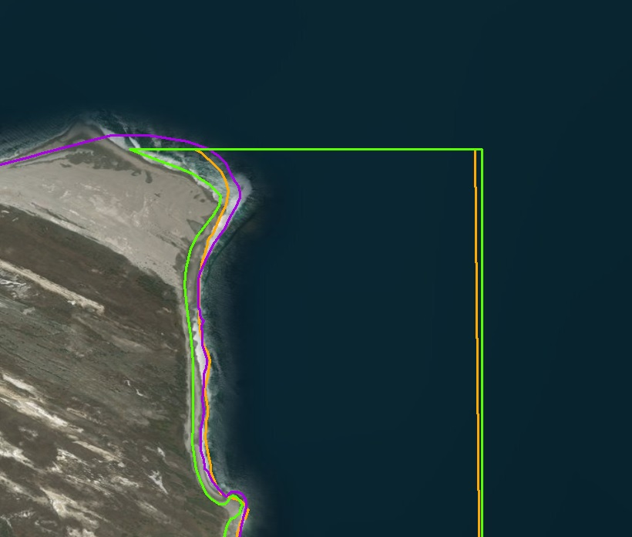
Illustrative Examples of Potential Mismatch
These sites, off the coast of Santa Rosa Island in California, all follow the coastline according to their regulatory description, yet you can see how the coastline data used for each site differs. In all three cases, boundaries were provided in digital format from each area’s respective government Management Authority. Each boundary follows a slightly different path even though they all share the same ‘coastline’.
Notes:
Our goal to to make this information available to as many users as possible
Stay up-to-date through legal alerts, listserves, and contacts with agencies

Slide 6
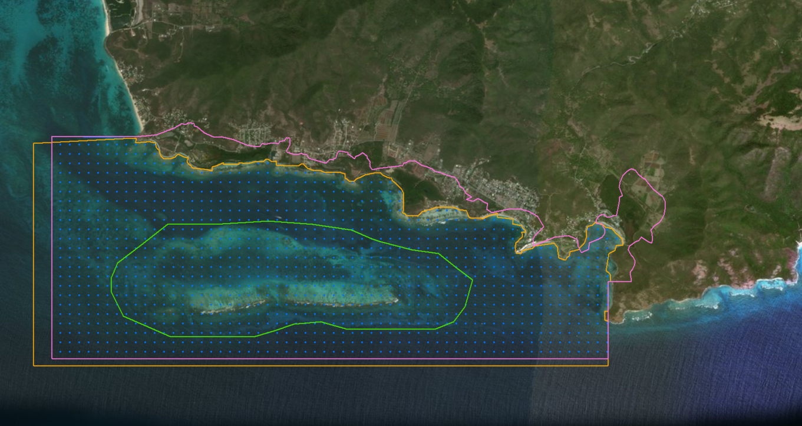
Illustrative Examples of Potential Mismatch
Cades Bay Marine Reserve (Antigua and Barbuda)
Blue dotted site: Digitized by ProtectedSeas using geographic coordinates listed in CaMPAM database
Orange site: NGO source 1 & 2
Pink site: UN WDPA boundary
Green site: NGO source 3
Notes:
Our goal to to make this information available to as many users as possible
Stay up-to-date through legal alerts, listserves, and contacts with agencies

Slide 7
Recommendations
S-122 areas defined by S-121 Zones should use the S-121 zone as the geometry object
Where S-122 areas share at least part of their boundaries with Maritime Limits but a suitable S-121 zone is not available
The S-122 should use the same boundary as the Maritime Limit at similar scales to avoid mismatch
Should S-122 validation require or recommend consistency checks of S-122 boundaries to S-121 Maritime limits published by the National Authority?

Slide 8
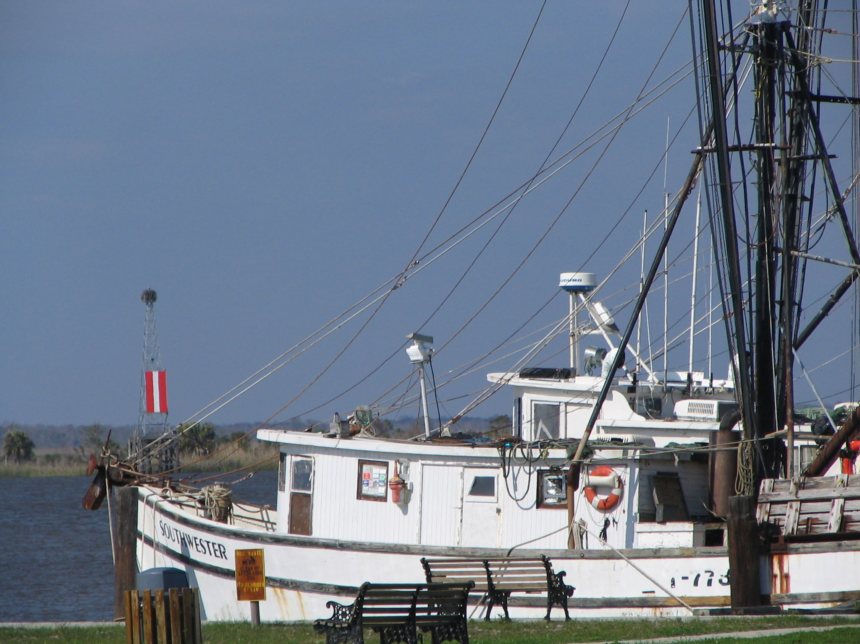
Thank you!
Notes:
See if M2 is applicable, try to integrate maybe?

